Slide 1
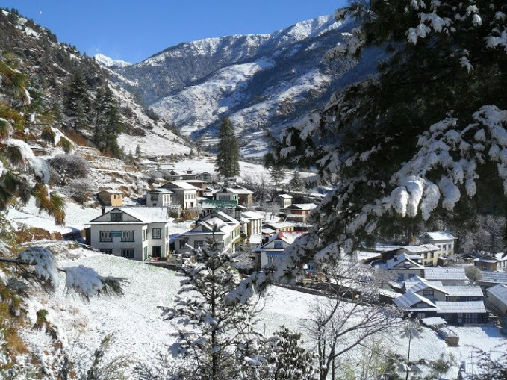
Tour Management System

Slide 2
Introduction
Tour management is web-based application which is designed to automate the travel process to the customers through online facilities for travelling, easy access to the relevant information and necessary travel booking and arrangement.
The complete information about the project has been highlighted in this project proposal. This application is going to add easiness for those users using such type of application and meet their satisfaction. This application will have various features for fulfilling the user requirement.

Slide 3
Problem Statement
In the current scenario, travelling is kind of hectic because of out dated map, dangerous travel routes, unguided routes, less information of the destination, no proper data records and so on.
Similarly, price of the travelling is monopoly accordingly.
With the help of the web application, it will be able to remove all the above problem smoothly.
Users will be able to get all the required information accordingly, proper safe routes etc.
Users will be able to select the desired destination accordingly to the proper budget.
Proper data records
More Secure.

Slide 4
Background Statement
This project will help users to get all the required information about the schedule and safe routes for their trip.
Solving this problem can uplift the range of tourism to go higher and increase the revenue too.
Through this, customers can be able to utilized various benefits and resources such as safe routes, booking, destination information, reviews about the places, environments etc.
The project will be developed using Object Oriented PHP.

Slide 5
Aims & Objectives
Online booking.
Saves time.
Accurate required information.
Efficient and User friendly application.
Proper destination guidance.
24X7 online service.
To help the organization to build a proper system to record the travelling information.

Slide 6
Features
User can view package information.
User can book the package.
User friendly and easy to use.
Admin can perform CRUD function.
Users can search the package.
Online service.
Easy checkout.
Integrated social elements.

Slide 7
Work Breakdown Structure (WBS)
The WBS is the systematic breakdown of project into small parts where each part is related and followed by another. It organizes the teams into manageable so that teams can understand each level of the project. It makes any complex project more manageable. It's used because:
It assists with accurate project organization.
It helps in assigning responsibilities.
It shows the control points and project milestones.
It allows for more accurate estimation of cost, risk and time.

Slide 8
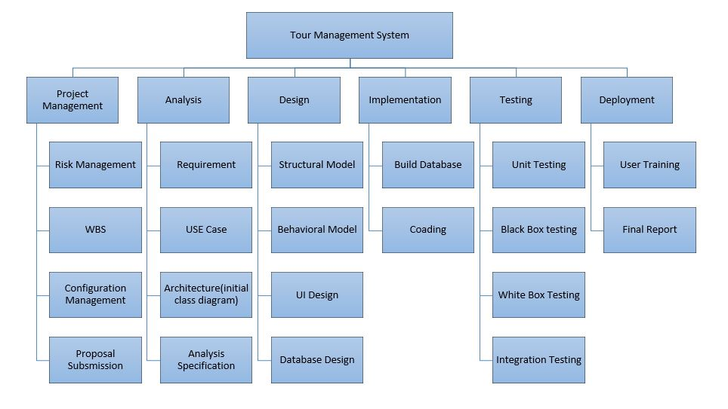

Slide 9
Gantt chart
A Gantt chart is a graphical tool also known as visual presentation of project which shows activities or tasks performed against time the activities are broken down and displayed on a chart which makes it easy to understand and interpret.

Slide 10
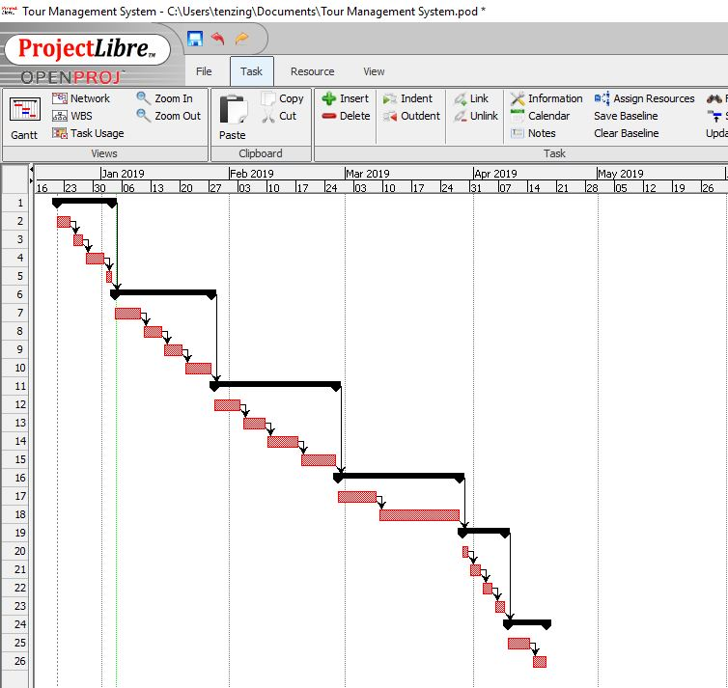

Slide 11
Development Methodology(Waterfall)
It is a framework which is used for planning, structure and control the process of developing an information system.
This model is simple and easy to understand and use.
Waterfall model works well for smaller projects where requirements are clearly defined and very well understood.
In this model phases are processed and completed one at a time. Phases do not overlap.
Easy to manage because of the rigidity of model and sequential design approach.

Slide 12
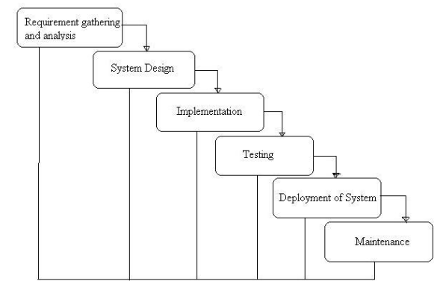

Slide 13
System Architecture
It is known as the art of constructing and design
Types such as N-tier, Two-tier and three- tier architecture.
Three-tier architecture is a client-server architecture in which the functional process logic, data access, computer data storage and user interface are developed and maintain independent modules on separate platform. The three tiers in this architecture are:
Presentation tier, Application tier, Data tier:
Three-tier architecture in my project because of the following reasons:
Easy to apply object-oriented concept
Easy to update data provider queries.
Easy to maintain and understand large project and complex project.
Database Security can be provided at application layer.

Slide 14
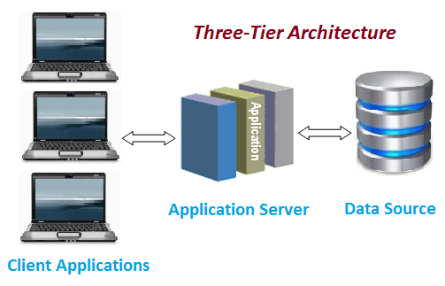

Slide 15
Risk Configuration Management
It is the process of developing and maintaining reliability of the performance, functions as well as the physical attributes of any product with its necessities, enterprise and functioning information during its entire life.
It helps to track and keep the detail of the data systematically so that it can be accessed easily when required.

Slide 16
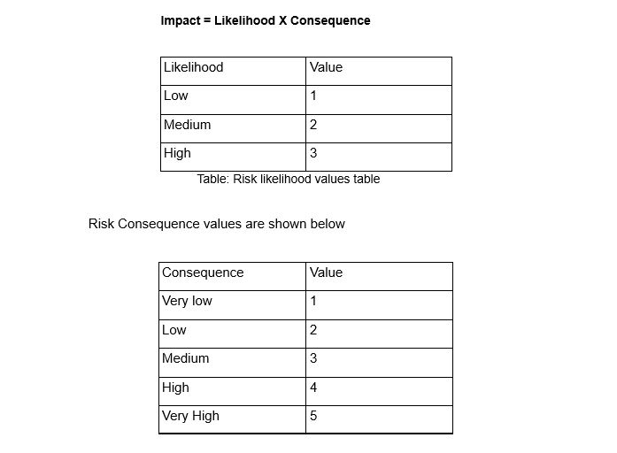

Slide 17
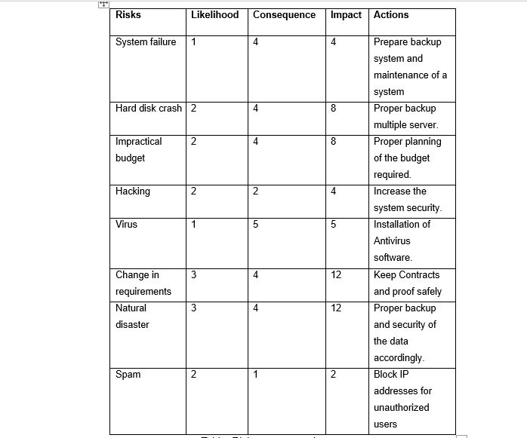

Slide 18
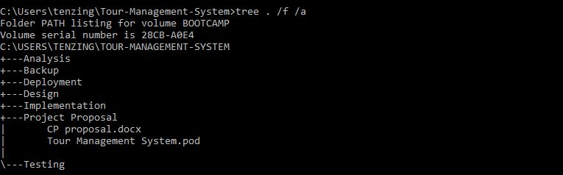

Slide 19
Initial Class Diagram
A class diagram is explanation/report of relationship in between different multiple classes. It is a static diagram that displays a static view of system and shows a collection of interface, classes and association. It also defines the attributes and operations of class.
Class diagram are simple and fast to read. Forward and reverse engineering.
To model the static view of an application, giving a sense of orientation.
They provide detailed insight into the structure of our systems, describing responsibilities of a system.

Slide 20
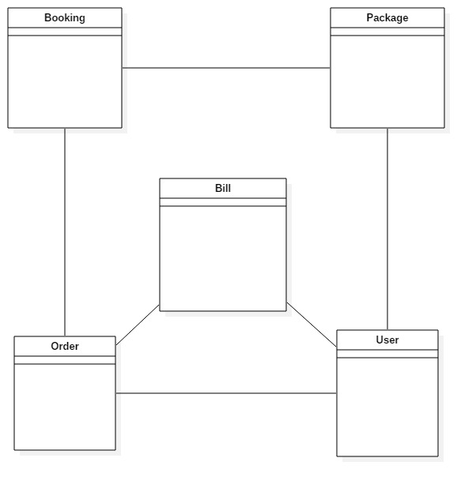

Slide 21
Class Diagram
It is used to illustrate and create a functional diagram of the system classes and serves as a system development resource within the software development life cycle.
Displaying each class has each controller and the controller are directly linked with the database.
Simple and easy to understand.
It helps to model the static view of an application and describes the responsibilities of the system.

Slide 22
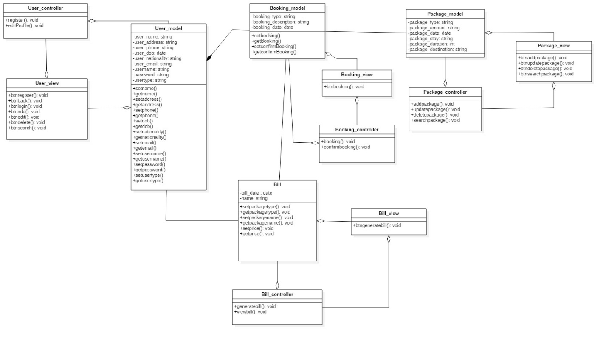

Slide 23
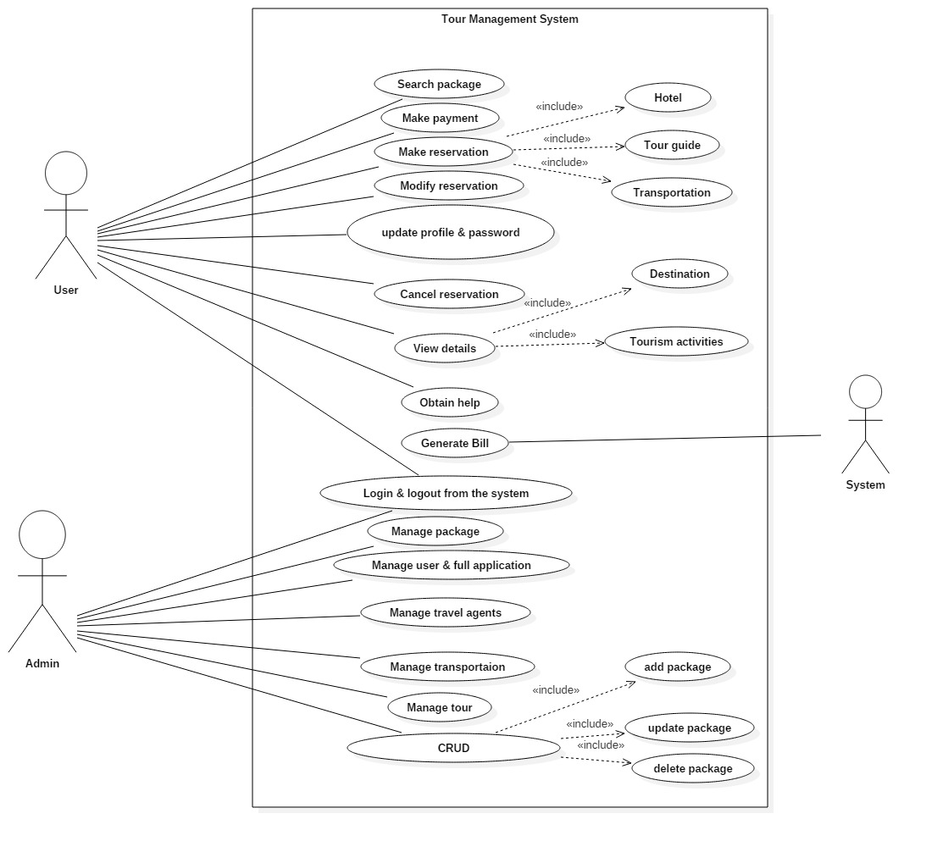
Use case Diagram

Slide 24
Activity diagrams
It is a UML diagram that describes the dynamic aspect as well as advanced version of flow chart which show logic of flow of one activity to another activity of the system.
The activity can be described as an operation of the system.
The flow can be sequential, branched or concurrent. It deals with all type of flow control by using different elements like fork, join etc.

Slide 25
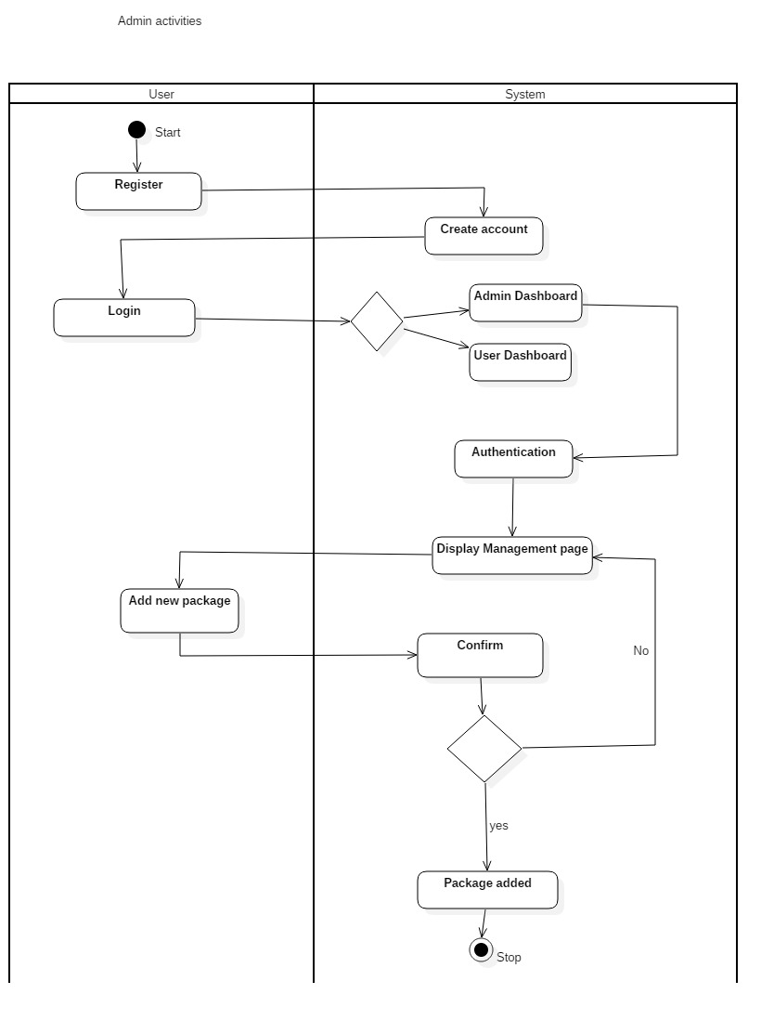

Slide 26
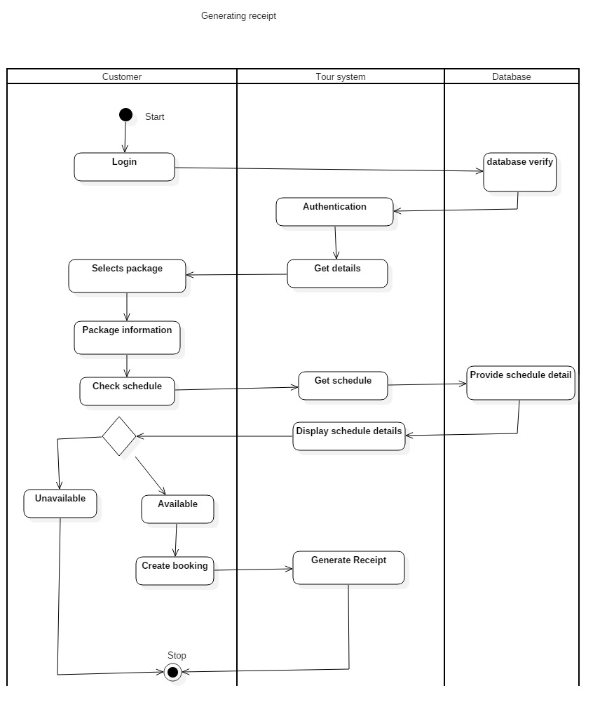

Slide 27
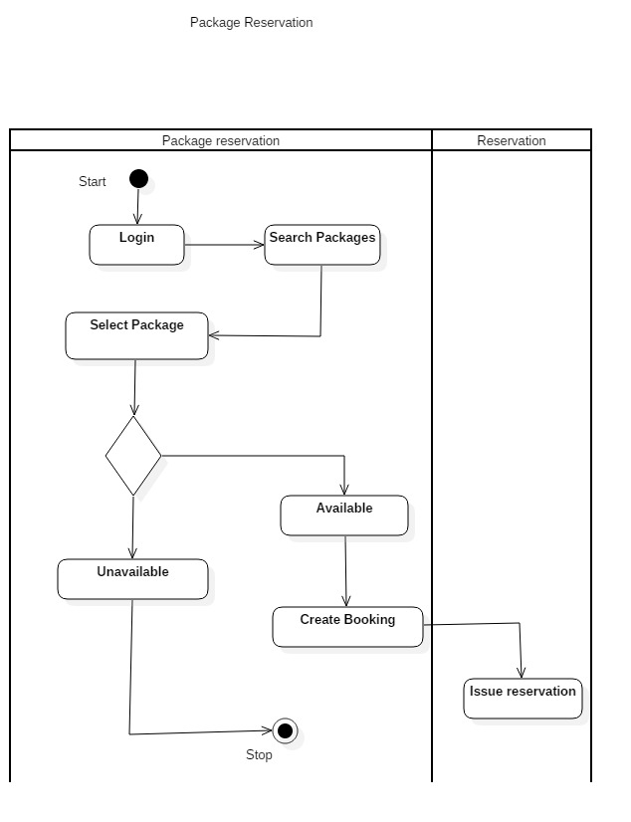

Slide 28
Sequence Diagram
A sequence diagram shows object interactions arranged in time sequence.
It depicts the objects and classes involved in the scenario and the sequence of messages exchanged between the objects needed to carry out the functionality of the scenario.
Sequence diagrams are typically associated with use case realizations in the Logical View of the system under development.
Sequence diagrams are sometimes called event diagrams or event scenarios.

Slide 29
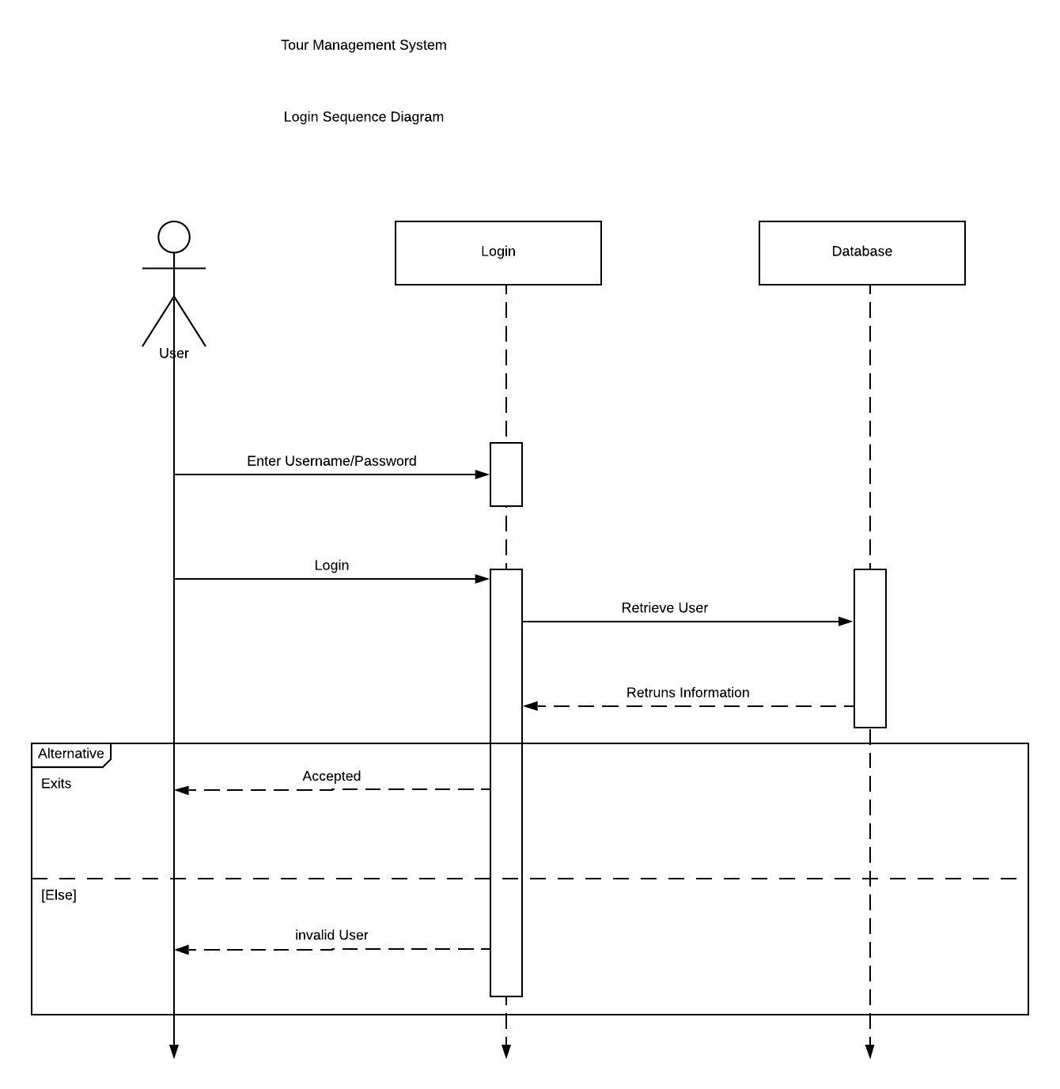

Slide 30
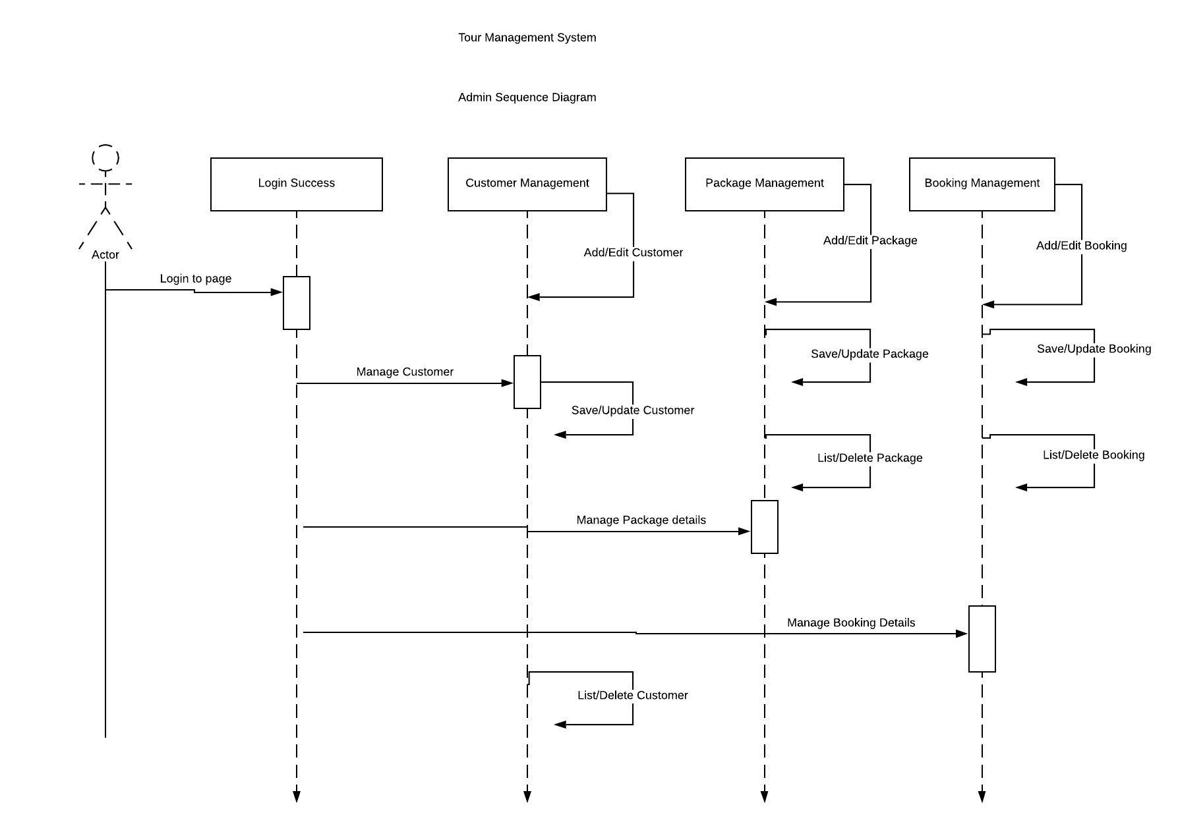

Slide 31
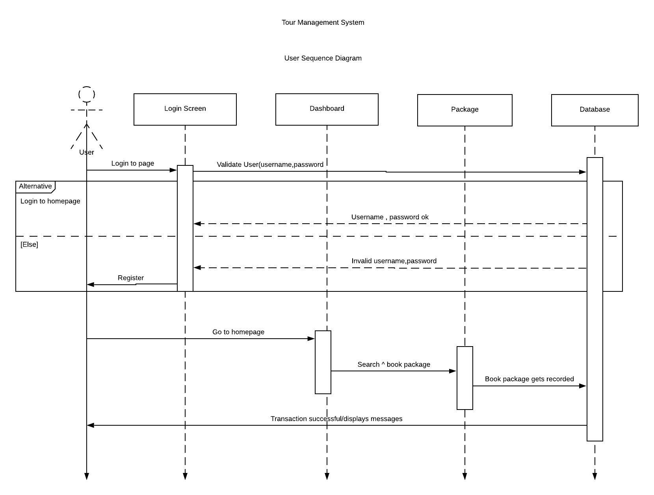

Slide 32
ER Diagram
An Entity Relationship Diagram also called as ERD is a type of flowchart that illustrates how entities relate with each other within system.
It helps to find out the mistakes and flaws of the design, and able to correct before executing the changes in database.
Easily the entities can be located by visualizing the database schema, attributes can be viewed and helps to identify the relationship.
Better visual representation and simple if we know relationship between entities and attributes.
An effective communication tool for database designer.

Slide 33
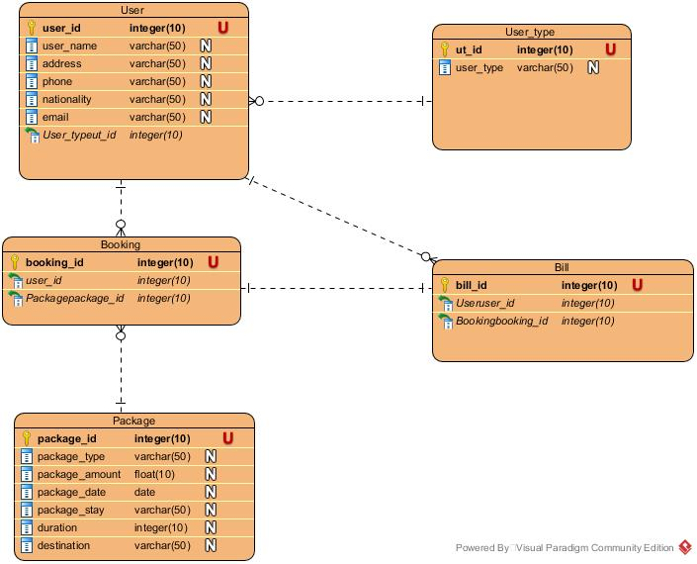

Slide 34
Coding and UI
Search Package.
Billing/Receipt.
Booking.

Slide 35
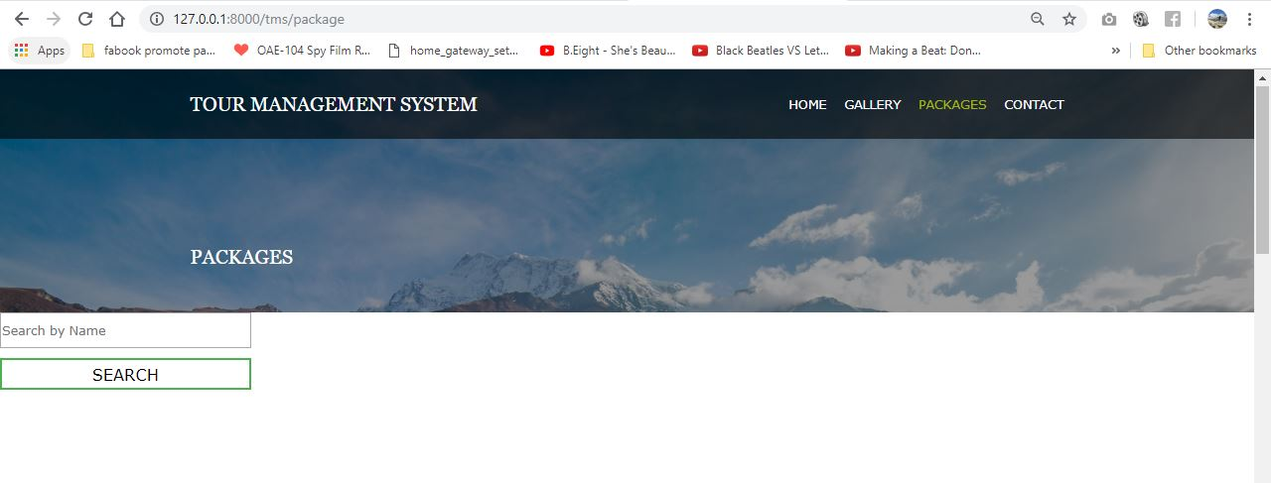
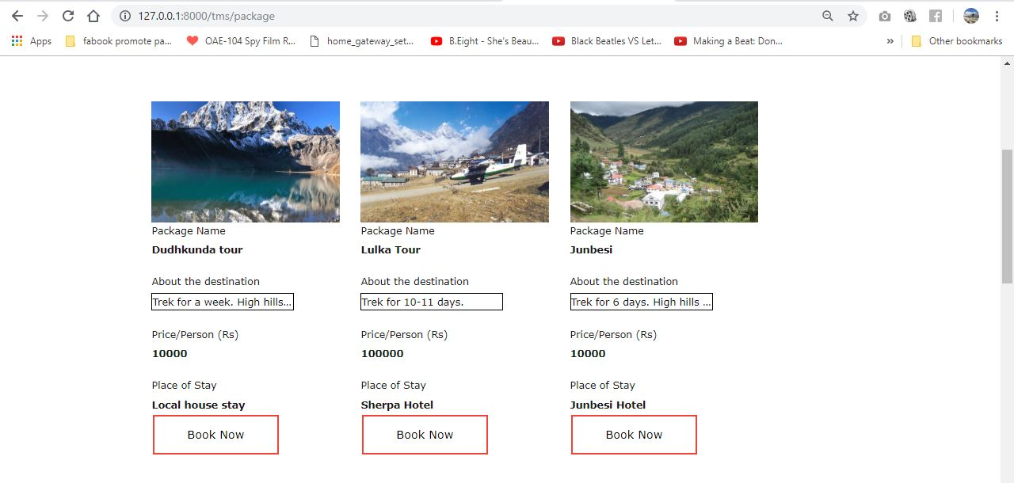

Slide 36
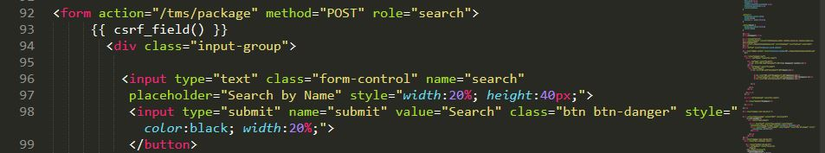
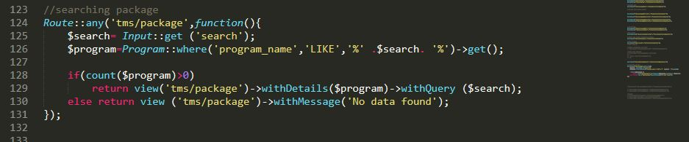

Slide 37
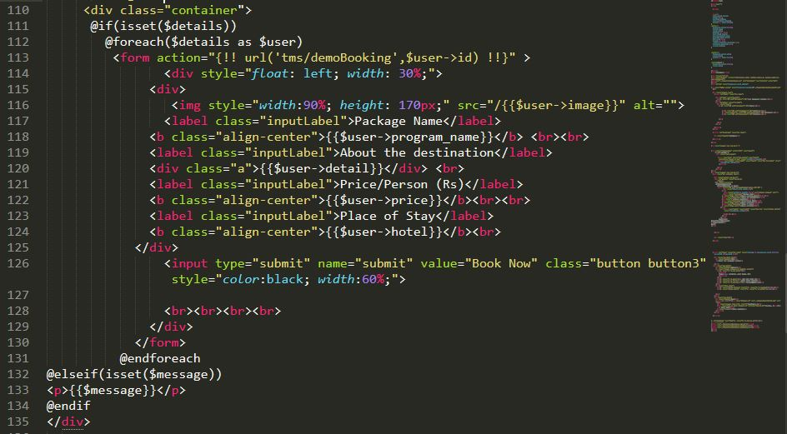

Slide 38
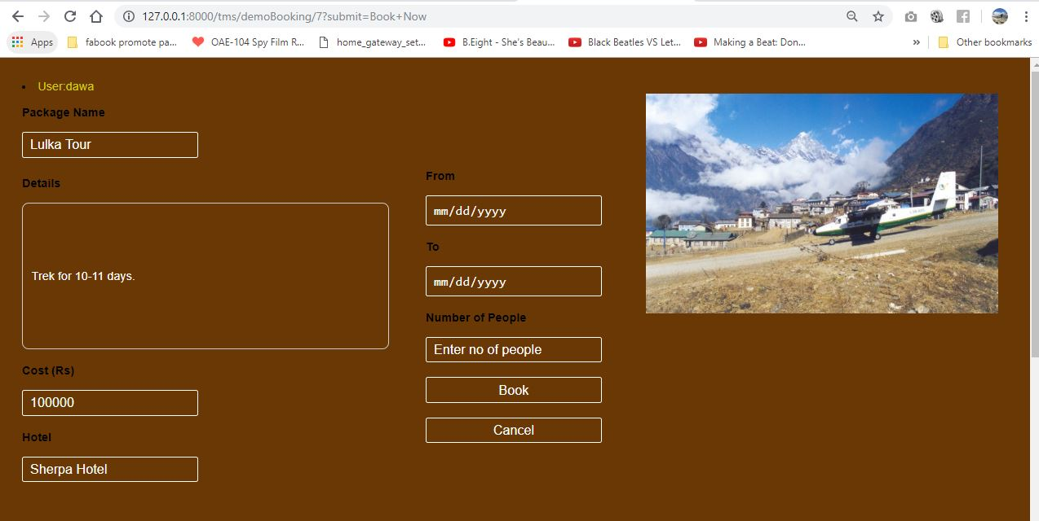

Slide 39
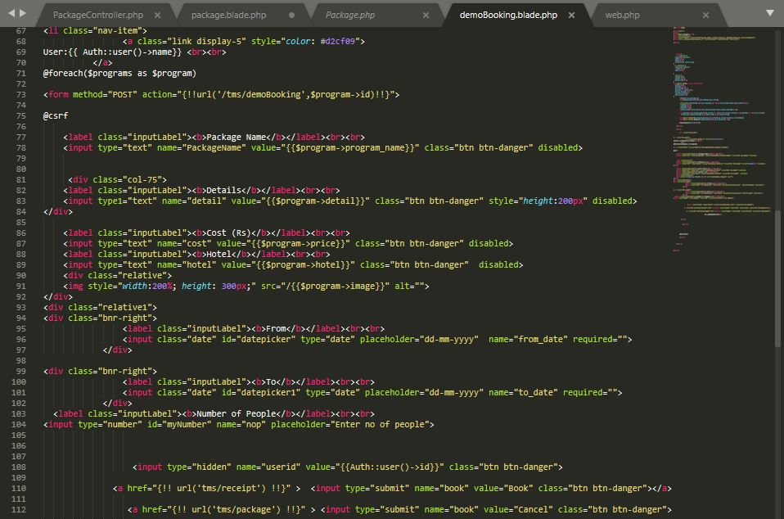

Slide 40
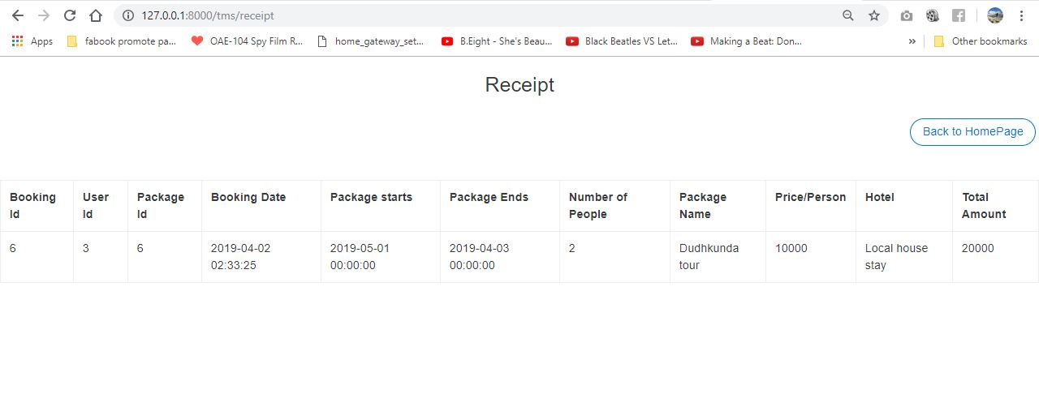

Slide 41
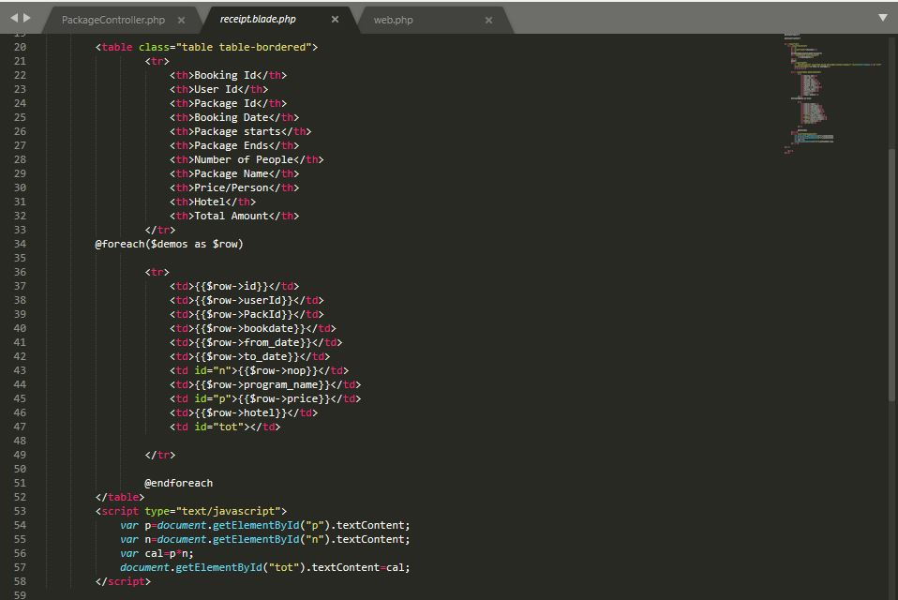

Slide 42
Testing
Testing is a process of executing a program with the aim of finding error.
To make our software perform well it should be error free.
If testing is done successfully it will remove all the errors from the software.
Testing performed for the project.
Backbox Testing.
Unit Testing.

Slide 43
Blackbox Testing
It is a software testing method in which the internal structure/design/implementation of the item being tested is not known to the tester.
These tests can be functional or non-functional, though usually functional.
Efficient when used on large systems.
Tester can be non-technical.
There is no need for the tester to have detailed functional knowledge of system.
Tests will be done from an end user's point of view, because the end user should accept the system. (This testing technique is sometimes also called Acceptance testing.)

Slide 44
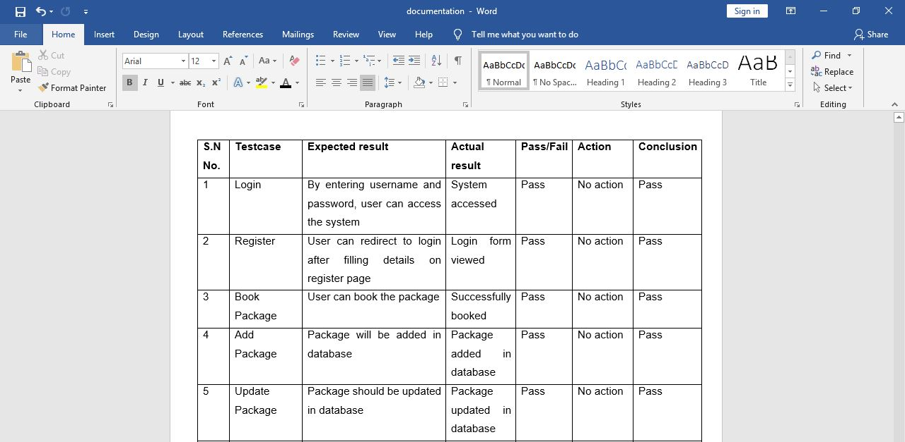
Blackbox Testing

Slide 45
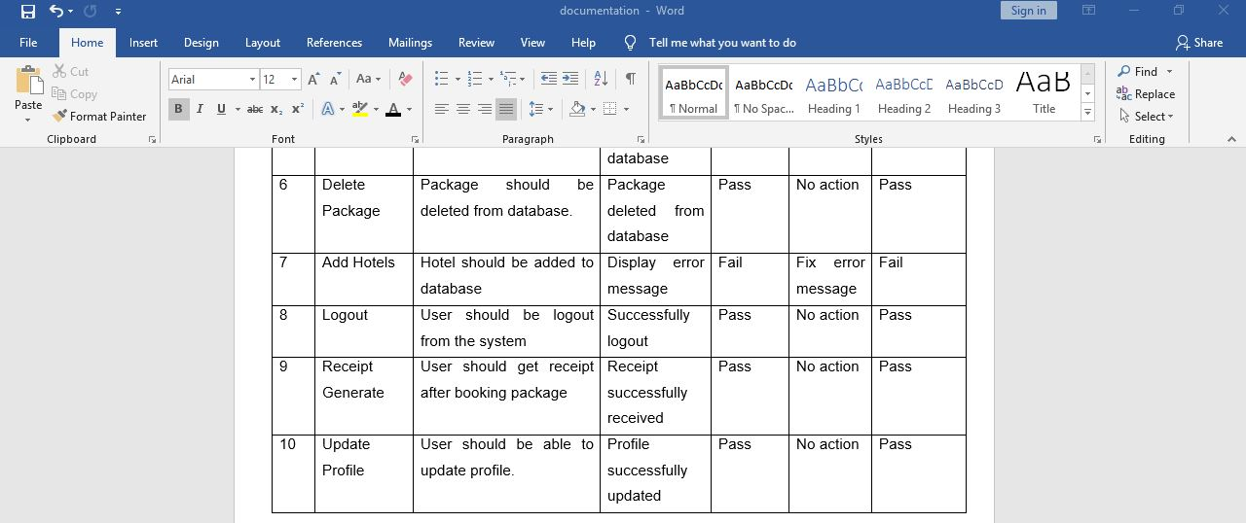

Slide 46
Future Work
Online Payment.
Real time tracking.
Chat Box.
Language options.
Ability to track booking status
Live seat availability

Slide 47
Limitation
Sometimes very high data interaction, so server gets down.
Very high security needed to the system.
Online payment cannot be made.
Step by step procedure, so takes time

Slide 48
User Manual

Slide 49
Conclusion
I have successfully completed the analysis phase of the developing software. In the completion of this phase, we have outcome the requirements, database model and user interface.

